Slide 1

Tours and Travels
Suyash Utekar-21104066
Atharva sutar-21104098
Kaushal patil-21104055
Yash shinde-21104029
Project Guide
Prof.Roshna Sangle

Slide 2
Contents
●
Introductionon
●
Objectives
●
Scope
●
Features / Functionality
●
Project Outcomes
●
Technology Stack
●
Block Diagram

Slide 3
1. Introduction
Tour & Travel is an irresistible word when it comes to tour and travel packages.
We offer tour and travel services including ticket bookings, hotel, holiday tour packages, and domestic tour packages.
We provide the most suitably designed as well as the customized travel packages to the customers.
Our website consist of admin page as well user page which is helpful for both user as well as admin to manage the trip and handle the customers respectively.

Slide 4
2. Objectives
To provide a easy platform for planning trips .
Our website offers multiple travelling plans which can be choosen respectively by users.
Accordingly prizing and trip brochure will be sent to the customer via email.
To provide a fast way planning and bookings
User can make their custom trip by availing customize trip option.

Slide 5
3. Scope
This can be useful for the people who cannot give more time on offline planning mode.
More over it provides facility to its users.
Also the software is going to provide a huge amount of summary data
The Website is developed based on real life. It is very helpful in business applications.
It offer tour and travel services including ticket bookings, hotel reservations, holiday tour packages, domestic tour packages only in one click.

Slide 6
4. Feature /Functionality
We also provide travel insurance which can be helpful for the user.
Hotel page: it provides a best rated and cozy hotels in a joyful envirement according to their likings
We provide various modes of travel that is Railway ,Flights ,Roadways etc.
Login/Register page: provides user to register himself on our website for creating his credentials to login in our website
We provide payment page through which user gets his tour confirmation quickly.

Slide 7
5. Outcome Of Project
It helps in keeping track of trip information entered by user.
It saves time as the admin can search trips available which will help admin at mess situation.
This is 24x7 service so admin can get information of customer details and its tours any time.
Systematic way of booking the tour and making the payment is available on the website.
User can get information about upcoming tours by entering in the account.
System provides a good security for user’s data as well as for admin’s data.

Slide 8
6. Technology Stack
PYTHON INTERPRETER
PYCHARM IDE
DJANGO FRAMEWORK
SQLITE 3
HTML
CSS

Slide 9
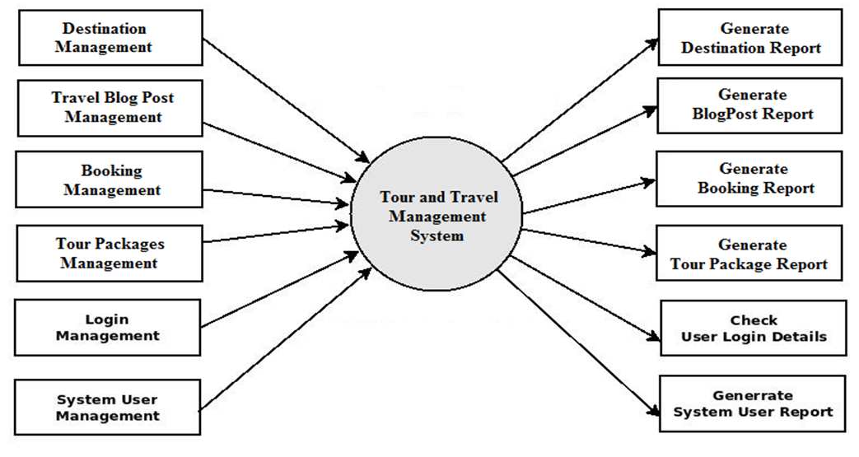
7. Block Diagram

Slide 10
THANK YOU

